Slide 1

Introduction to Neural Networks
DATA ANALYTICS | IRONHACK
Understanding the Basics

Slide 2

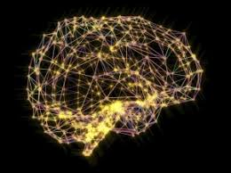
IRONHACK BOOTCAMP
What is a Neural Network?
A neural network is a series of algorithms that attempts to recognize underlying relationships in a set of data through a process that mimics the human brain.
It is composed of layers of nodes (neurons), where each layer transforms the input data into more abstract representations.

Slide 3
IRONHACK BOOTCAMP
Basic Structure
Input Layer: Receives input data.
Hidden Layers: Intermediate layers that process inputs.
Output Layer: Produces the final output. .

Slide 4
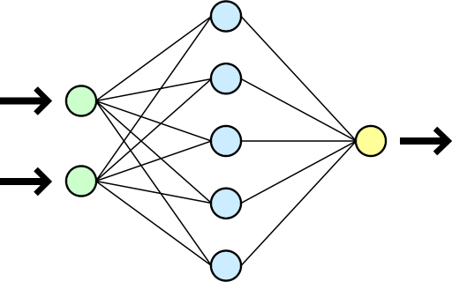

Slide 5
IRONHACK BOOTCAMP
Neurons and Activation Functions
Neuron: The basic unit, processes inputs by applying weights, adding bias, and passing through an activation function.
Activation Function: Determines whether a neuron should be activated (e.g., Sigmoid, ReLU, Tanh).

Slide 6
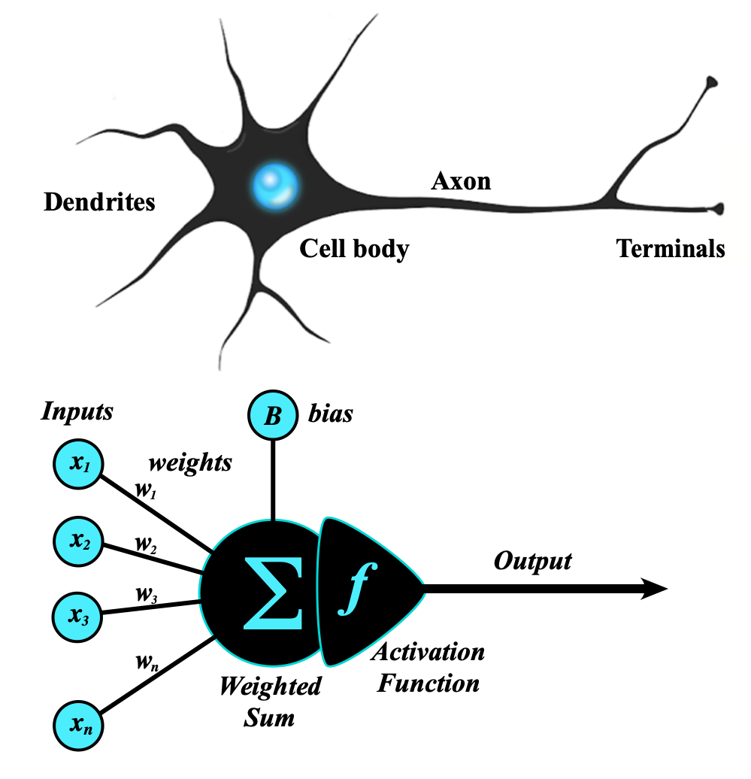

Slide 7
IRONHACK BOOTCAMP
Example
We want to build a model that predicts if an IronHack student graduates or not ( binary variable, fail or pass) , based on the hours they’ve studied and their number of absences ( 2 inputs ). A simple neural network structure might look like this:

Slide 8
IRONHACK BOOTCAMP
Example
Input layer: Has 2 neurons, one for each input ( Hours studied and absences )
Hidden layer: We will have 3 neurons in this layer. Each input neuron is connected to each hidden neuron, and weights are assigned to each connection.
Output Layer: This layer will have 1 neuron, connected to to all 3 neurons in the hidden layer. It will have a threshold (using a sigmoid activation function, for example) to classify the result ( The Ironhacker passed or failed ).

Slide 9
IRONHACK BOOTCAMP
Training a Neural Network
Forward Propagation: Passing inputs through the network to get the output.
Loss Function: Measures the difference between predicted and actual outputs.
Backpropagation: Adjusts weights using the gradient of the loss function to minimize errors.
Optimization: Gradient Descent or Adam, for example.

Slide 10
IRONHACK BOOTCAMP
Common Types of Neural Networks
Feedforward Neural Networks (FNN): The simplest form, where connections do not form cycles.
Convolutional Neural Networks (CNN): Specializes in processing grid-like data such as images.
Recurrent Neural Networks (RNN): Designed to handle sequential data, with feedback loops.

Slide 11
IRONHACK BOOTCAMP
Real-World Applications
Image Recognition: Face detection, object classification.
Natural Language Processing: Sentiment analysis, translation.
Finance: Stock price prediction, fraud detection.
Healthcare: Disease diagnosis, personalized medicine.

Slide 12
IRONHACK BOOTCAMP
Challenges and Limitations of Neural Networks
Overfitting
Data Requirements: Requires large amounts of data for training.
Computational Resources: High demand for processing power and time.
Interpretability: Neural networks are often seen as black boxes.

Slide 13
IRONHACK BOOTCAMP
The Future of Neural Networks
Advancements: Continued research in deep learning, reinforcement learning.
Ethical Considerations: AI ethics, bias in algorithms.
Integration: Increasing use in various industries, IoT, automation.

Slide 14
IRONHACK BOOTCAMP
Summary
Neural networks are a powerful tool for machine learning and AI.
Applications are vast, but challenges remain in interpretability and data requirements.
Computational resources are a big challenge

Slide 15
IRONHACK BOOTCAMP
Q&A

Slide 16


